Slide 1
Growth & Guarantees:
Maximizing Penn Mutual Variable Products with Vanguard Investments
April 2, 2025
For financial professional use only.
© 2025 Penn Mutual. All rights reserved.

Slide 2

GROWTH AND GUARANTEES
Today’s Presenters
Matthew Nadler, CFA®, CAIA®,
Key Account Executive
Vanguard Financial Advisor Services™
Michael Siebecker, ASRI
Director: Annuity Product Wholesaler
Penn Mutual
For financial professional use only.
© 2025 Penn Mutual. All rights reserved.

Slide 3
Vanguard Investment Options & Performance
Agenda
Penn Mutual’s Variable Products: Strength in Guarantees
Bringing It All Together: Driving Sales Success
Q & A Session
For financial professional use only.
© 2025 Penn Mutual. All rights reserved.

Slide 4
Vanguard Investment Options & Performance
Matthew Nadler, CFA®, CAIA®,
Key Account Executive
Vanguard Financial Advisor Services™
For financial professional use only. © 2025 Penn Mutual. All rights reserved.
4

Slide 5
5

Slide 6
6

Slide 7
7

Slide 8
8

Slide 9
9

Slide 10
10

Slide 11
11

Slide 12
12

Slide 13
13

Slide 14
14

Slide 15
15

Slide 16
16

Slide 17
17

Slide 18
18

Slide 19
19

Slide 20
Penn Mutual’s Variable Products: Strength in Guarantees
Michael Siebecker, ASRI
Director: Annuity Product Wholesaler
Penn Mutual
For financial professional use only. © 2025 Penn Mutual. All rights reserved.
20

Slide 21
Penn Mutual Life Product Portfolio
Term | Whole Life | Fixed UL | Indexed UL | Variable UL
Guaranteed Convertible Term Protection Non-Convertible Term | Accumulation WL Protection WL Survivorship WL | Guaranteed Protection UL Protection UL | Accumulation IUL Survivorship IUL | Accumulation VUL Protection VUL Survivorship Protection VUL
Risk tolerance and market-based growth
Lower HIGHer
For financial professional use only. © 2025 Penn Mutual. All rights reserved.
21

Slide 22



Diverse Investment Options
AVUL Competitive Product Features:
Diverse product features allow AVUL to adapt to your client’s needs throughout different life stages
Lower cost Vanguard separate account portfolio
Three indexed account options
Three fixed account options
Variety of ways to access Cash Value
Traditional Loans with preferred loans beginning in Year 6
Indexed Loans with a guaranteed 6% loan rate and 1% floor on loaned values
Additional Product Features
Overloan Protection Benefit Rider
Two early cash value riders for balance sheet needs
Competitive target premiums and rolling target compensation
For financial professional use only.
© 2025 Penn Mutual. All rights reserved.

Slide 23
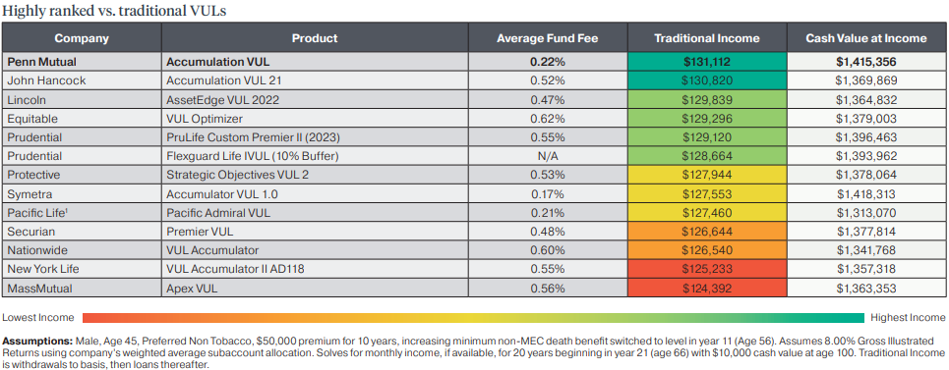

AVUL Competitive Edge
Strong income with cash value growth opportunities
Assumptions: Male, Age 45, Preferred Non Tobacco, $50,000 premium for 10 years, increasing minimum non-MEC death benefit switched to level in policy year 11 (Age 56). Assumes 8.00% Gross Illustrated Returns using company’s weighted average subaccount allocation. Solves for monthly income, if available, for 20 years with $10,000 cash value at age 100. Traditional Income is withdrawals to basis, then loans thereafter.
¹ Pacific Life uses 33% commissionable premium term blend
For financial professional use only.
© 2025 Penn Mutual. All rights reserved.
Notes:
Slides 36 – 38 – we need to use multi colors here (not just greens and slates) to differentiate. Can you check against our brand and make recommendations. No lines between.

Slide 24
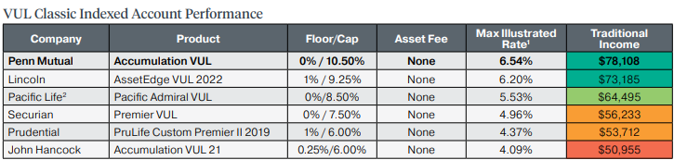
AVUL Competitive Edge
Highly ranked for income when compared other VUL indexed accounts
¹ Pacific Life uses a 30% commissionable premium term blend
For financial professional use only.
© 2025 Penn Mutual. All rights reserved.
Notes:
Slides 36 – 38 – we need to use multi colors here (not just greens and slates) to differentiate. Can you check against our brand and make recommendations. No lines between.

Slide 25
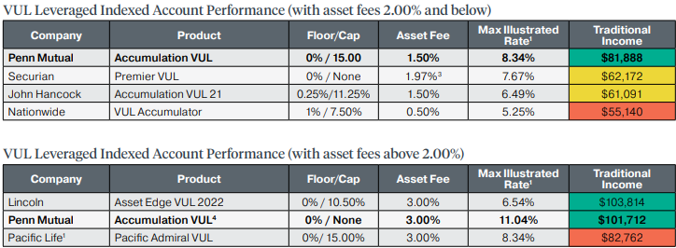
AVUL Competitive Edge
Highly ranked for income when compared other VUL indexed accounts
¹ Pacific Life uses a 30% commissionable premium term blend
² Securian’s Optimzer2 account has a 65% participation rate, annual segment charge of 1.25% and a monthly index account charge of 0.06%. Penn Mutual’s Uncapped account (limited by participation rate) with a 95% Participation Rate
For financial professional use only.
© 2025 Penn Mutual. All rights reserved.
Notes:
Slides 36 – 38 – we need to use multi colors here (not just greens and slates) to differentiate. Can you check against our brand and make recommendations. No lines between.

Slide 26
Penn Mutual Annuity Product Portfolio
Term | Whole Life | Fixed UL | Indexed UL | Variable UL
Guaranteed Convertible Term Protection Non-Convertible Term | Accumulation WL Protection WL Survivorship WL | Guaranteed Protection UL Protection UL | Accumulation UL Survivorship UL | Accumulation UL Protection UL Survivorship Protection UL
Risk tolerance and market-based growth
Lower HIGHer
Fixed Immediate Annuity
Fixed
Annuity
Indexed
Annuity
Variable Annuity
Single Premium Immediate Annuity (SPIA)
Guaranteed Foundation Fixed Annuity (GFFA)
Premier Foundation Indexed Annuities (PFIA)
Smart Foundation Variable Annuities (SFVA) and Deferred Variable Annuity (DVA)
Penn Mutual Annuities not offered in New York.
26
For financial professional use only. © 2025 Penn Mutual. All rights reserved.
Notes:
There are three main categories of annuity products to meet your clients’ retirement planning needs. For clients with a lower risk tolerance that want a return potential that is guaranteed, there are fixed immediate and deferred annuities. Fixed Immediate annuities provide income now while deferred annuities are designed for long-term accumulation and income later.
For clients with a greater risk tolerance that want some upside potential yet also do not want to risk their principal, an option to consider may be a fixed indexed annuity. This option offers an annuity with an indexed account that offers a cap on earnings and the downside protection of an earnings floor.
Variable Annuities are available for clients with a higher risk tolerance as they offer the upside potential of investing in a host of sub-account options. However, with that upside potential also comes the risk of negative market returns.

Slide 27
Diverse Investment Options
DVA Competitive Product Features:
Designed to help clients grow retirement savings and meet their unique retirement income goals
Lower cost Vanguard separate account portfolio
Three asset allocation funds
Three fixed account options
Guaranteed Lifetime Income Riders
Guaranteed Income Rider (GIR) provides clients with 7% guaranteed growth
Accumulation Income Rider (AIR) provides clients with some of the highest guaranteed withdrawal rates in the industry
Additional Product Features
Guaranteed Minimum Accumulation Rider
Enhanced Death Benefit Rider
For financial professional use only.
© 2025 Penn Mutual. All rights reserved.

Slide 28
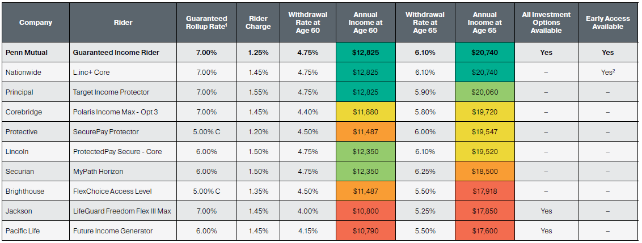


GIR Competitive Edge
Competitively priced and top ranked for guaranteed lifetime income
Assumptions: Age 55, $200,000 purchase payment, guaranteed lifetime withdrawals taken at ages 60 or 65, assuming 0% return
¹ Rollup Rate is a simple interest rate unless indicated otherwise; C indicates compound interest method. ² Nationwide's non-lifetime withdrawal feature can only be exercised once.
Information based on Penn Mutual and competitor illustrations and is believed to be accurate as of May 2024. This information is subject to change.
For financial professional use only.
© 2024 Penn Mutual. All rights reserved.
28

Slide 29
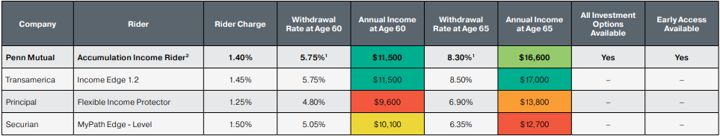
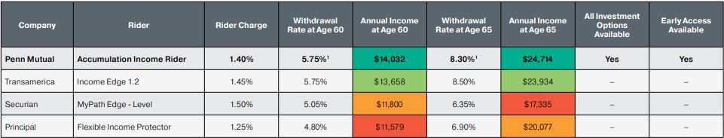
AIR Competitive Edge
Competitive upside potential for guaranteed lifetime income
Assumptions: Age 55, $200,000 purchase payment, withdrawals at 60 and 65, assuming 0% return
Assumptions: Assumptions: Age 55, $200,000 purchase payment, withdrawals at 60 and 65, assuming gross 7% return
¹Penn Mutual’s Accumulation Income Rider includes a waiting bonus of 0.25% for ever year waited to start income (max of 10 years) and assumes a 0.14% fund fee for the Vanguard Equity Index Fund.
For financial professional use only.
© 2025 Penn Mutual. All rights reserved.
29

Slide 30
Case Study
For financial professional use only.
© 2025 Penn Mutual. All rights reserved.
30

Slide 31

Case Study: Lifetime Income and Providing a Legacy
John and Jane recently sold their business
Both Age 60
Goals
Annual income need of $120,000
Would like to leave each son $1M at last death
Would like at least $100,000 available now for three trips planned over the next 18 months
After settlement, they have $3M for planning as a result of the sale
Have additional assets outside of this from a lifetime of saving and investing
Have three adult sons that were also heavily involved in the business
For financial professional use only.
© 2025 Penn Mutual. All rights reserved.

Slide 32
How to Breakdown their $3M Investment to Accomplish their Goals
SPIA
DVA
SPVUL
SPIA 1: Meets $120k annual income goal for 10 years
$973,829.14 Invested
SPIA 2: Funds SPVUL premiums
$524,804.81 Invested
GIR: $811,360 Invested
Payments begin in 10 years at age 70 to meet annual income goal
AIR: $496,900 Invested
Payments begin in 10 years at age 70 to meet annual income goal
$3M Death Benefit
10-Pay Funded with:
$72,055 in first year from Cash
$72,055 in years 2-10 from SPIA 2
Leaves $121,051.05 cash available to meet their travel goals
For financial professional use only.
© 2025 Penn Mutual. All rights reserved.

Slide 33
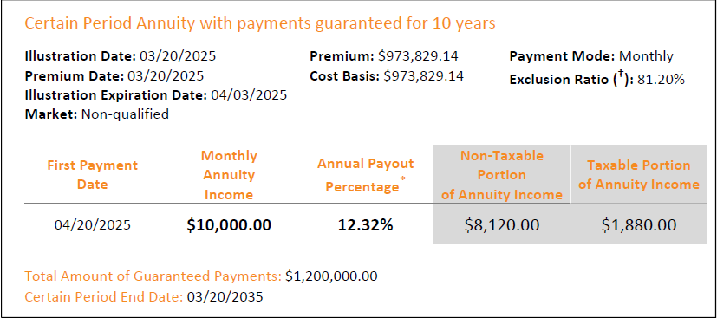

Goal #1: Provide $120,000 in annual income
Assumptions: 60 year old male, SPIA Period Certain for 10 years
SPIA 1 provides $10,000 per month, or $120,000 per year, for the first ten years
All guarantees are based on the claims-paying ability of the issuer
For financial professional use only.
© 2025 Penn Mutual. All rights reserved.
33

Slide 34
10%
Total Bond Market Index
Manager: Vanguard Fixed Income Group
Seeks to track the performance of the Bloomberg U.S. Aggregate Float Adjusted Bond Index
Provides interest income with high credit quality
How will John and Jane invest?
25%
Balanced Portfolio
Manager: Wellington Management Company
Seeks long-term capital appreciation and reasonable current income, with moderate risk
Fundamental, risk-controlled investment approach
They have a moderate risk tolerance and 10+ years to invest
65%
Capital Growth Portfolio
Manager: PRIMECAP Management Company
Seeks long-term capital appreciation
Multi-cap growth equity, emphasizing large- and mid-cap issues
For financial professional use only.
© 2025 Penn Mutual. All rights reserved.

Slide 35
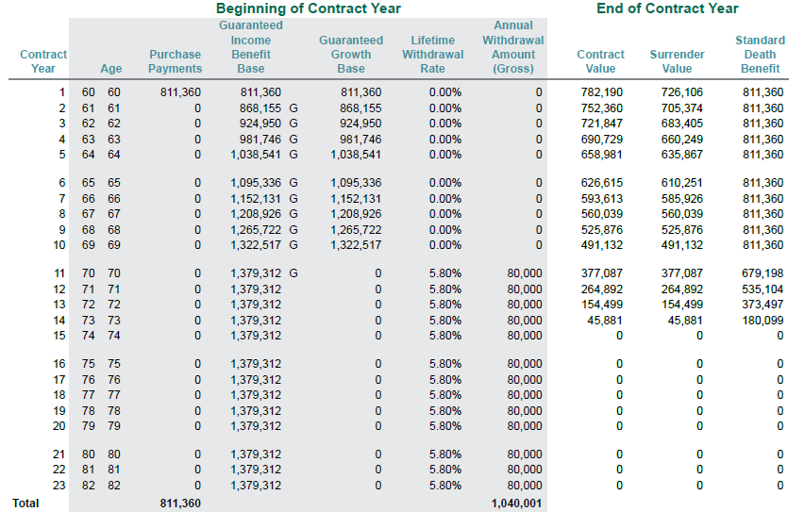
Goal #1: Provide $120,000 in annual income
Assumptions: 60 year old male and 60 year old female, DVA with GIR joint life benefit, 0% assumed gross annual ROR
After 10 years, John and Jane begin taking income from their DVA contracts
As a worst case scenario, DVA with GIR guarantees them $80,000 per year
All guarantees are based on the claims-paying ability of the issuer
For financial professional use only.
© 2025 Penn Mutual. All rights reserved.
35

Slide 36
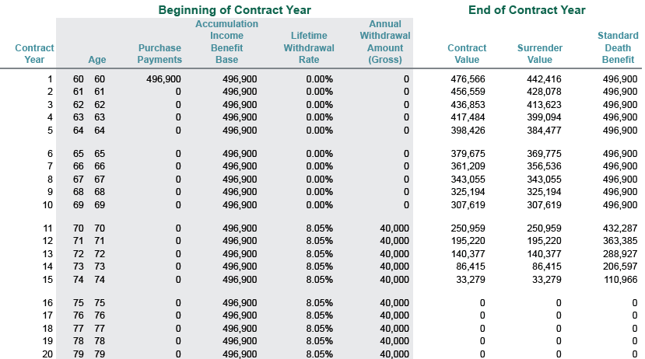
Goal #1: Provide $120,000 in annual income
Assumptions: 60 year old male and 60 year old female, DVA with AIR joint life benefit, 0% assumed gross annual ROR
After 10 years, John and Jane begin taking income from their DVA contracts
As a worst case scenario, DVA with AIR guarantees them $40,000 per year
Combining the two contracts, they are guaranteed a minimum of $120,000 per year with the opportunity to increase their income with step-ups
All guarantees are based on the claims-paying ability of the issuer
For financial professional use only.
© 2025 Penn Mutual. All rights reserved.
36

Slide 37
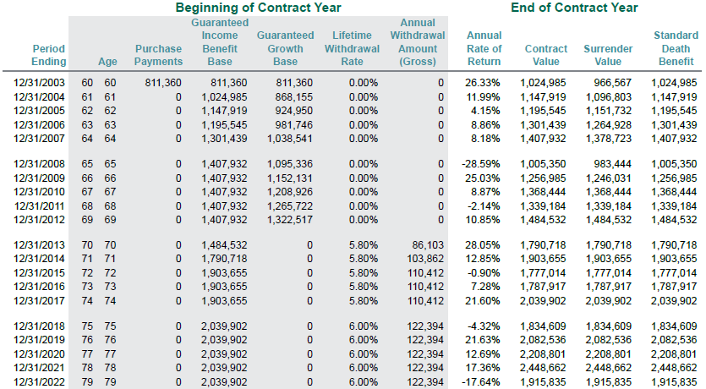
Goal #1: Provide $120,000 in annual income
Assumptions: 60 year old male and 60 year old female, DVA with GIR joint life benefit, invested 10% Total Bond Market Index, 25% Balanced Portfolio and 65% Capital Growth Portfolio, 8.30% average annual ROI
After 10 years, John and Jane begin taking income from their DVA contracts
In this hypothetical return, DVA with GIR provides them with even more income
This provides them with the income they need for the rest of their lives – and the opportunity for their income to increase
All guarantees are based on the claims-paying ability of the issuer
For financial professional use only.
© 2025 Penn Mutual. All rights reserved.
37

Slide 38
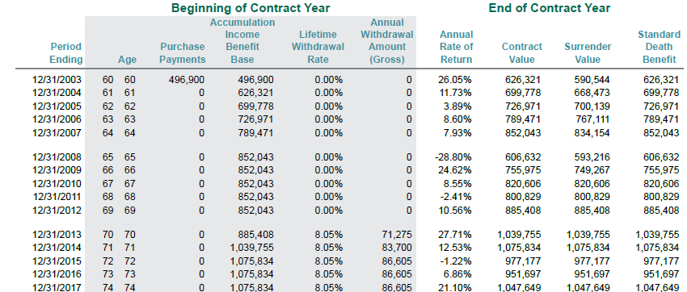

Goal #1: Provide $120,000 in annual income
Assumptions: 60 year old male and 60 year old female, DVA with AIR joint life benefit, invested 10% Total Bond Market Index, 25% Balanced Portfolio and 65% Capital Growth Portfolio, 7.87% average annual ROI
After 10 years, John and Jane begin taking income from their DVA contracts
In these historical examples, the two contracts combined guaranteed $86,103 (GIR) and $71,275 (AIR) for a total of $157,378 of income at age 70 and it continues to increase over time
All guarantees are based on the claims-paying ability of the issuer
For financial professional use only.
© 2025 Penn Mutual. All rights reserved.
38

Slide 39
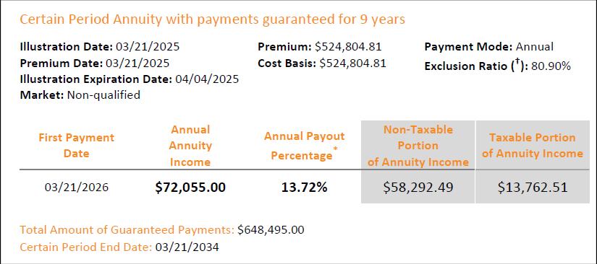
Goal #2: Provide $1M to each son at last death
Assumptions: 60 year old male, SPIA Period Certain for 9 years
The first year’s premium is funded from cash
SPIA 2 provides $72,055 per year for nine years to fund the SPVUL policy
All guarantees are based on the claims-paying ability of the issuer
For financial professional use only.
© 2025 Penn Mutual. All rights reserved.
39

Slide 40
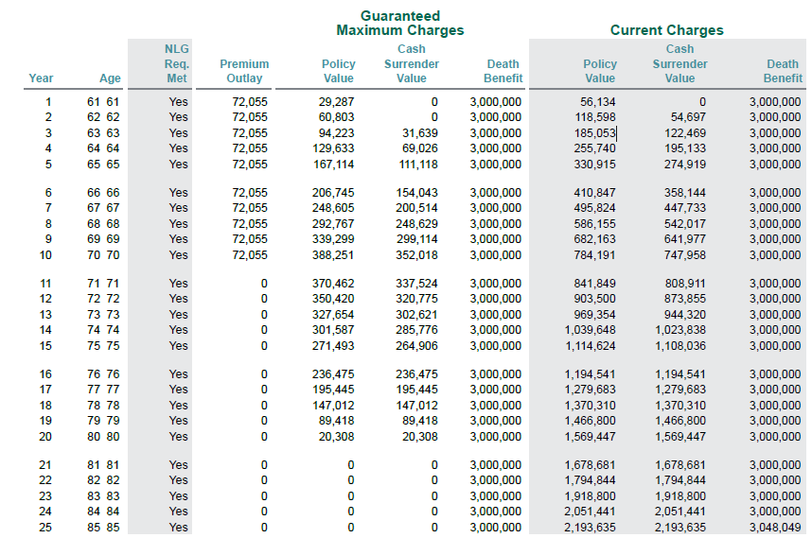
Goal #2: Provide $1M to each son at last death
Assumptions: 60 year old male, preferred non-tobacco and 60 year old female, preferred non-tobacco, invested 10% Total Bond Market Index, 25% Moderate Allocation and 65% Total Stock Market Index, 8% gross ROR
SPVUL guarantees John and Jane a $3M death benefit upon the last death
This meets their goal of providing $1M to each of their three sons when they both pass away
All guarantees are based on the claims-paying ability of the issuer
For financial professional use only.
© 2025 Penn Mutual. All rights reserved.
40

Slide 41
Goal #3: Provide $100,000 Cash for Travel
Starting Assets $3,000,000
Invested - $973,829.14: SPIA #1 (120 months of $10K payments – $120K annual – goal number one)
- $72,055.00: Pays first annual premium on SPVUL (goal number two) $3M SPVUL – 10 Pay
- $524,804.81: SPIA #2 (defer one year make 9 annual payments of $72,055 to pay last nine years of
premium due on SPVUL)
- $811,360: Fund DVA GIR – payments begin in contract year 11 (Age 70)
- $496,900: Fund DVA AIR – payments begin in contract year 11 (Age 70)
Leaves $121,051.05 for travel and meets their goal
For financial professional use only.
© 2025 Penn Mutual. All rights reserved.
41

Slide 42
Case Study Solution
Leveraging a personalized solution tailored to meet all of their goals, John and Jane were able to successfully maximize their assets to provide them with substantial guaranteed lifetime income and meet their legacy and travel goals
Goals
Met their annual income need of $120,000+
Met their legacy goal: SPVUL guarantees each son $1M at last death
Met their goal of having $100k+ cash available now to enjoy their planned trips
John & Jane
For financial professional use only.
© 2025 Penn Mutual. All rights reserved.
42

Slide 43
Resources
For financial professional use only.
© 2025 Penn Mutual. All rights reserved.
43

Slide 44





Resource Highlights
Check out all the latest marketing materials and product information on Gateway
Access value-add and investment information on Vanguard’s website
Details on Vanguard options available in Penn Mutual products
For financial professional use only.
© 2025 Penn Mutual. All rights reserved.

Slide 45
Questions?
45
For financial professional use only. © 2025 Penn Mutual. All rights reserved.

Slide 46
Thank you!
46
For financial professional use only. © 2025 Penn Mutual. All rights reserved.

Slide 49
For Financial Professional Use Only.
All guarantees are based on the claims-paying ability of the issuer.
Accumulation Whole Life (Policy form number ICC18-TL) is a whole life insurance policy offered by The Penn Mutual Life Insurance Company. Policy form number may vary by state. Product, riders and features may not be available in all states. This product is not offered in New York. Riders may be subject to eligibility and underwriting requirements, additional premium requirements and/or minimum or maximum coverage amounts.
Accumulation Variable Universal Life (ICC23-PI-VFL) is a flexible premium, adjustable variable universal life insurance policy offered by The Penn Insurance and Annuity Company, a wholly-owned subsidiary of The Penn Mutual Life Insurance Company. Product and/or features may not be available in all states. Policy form number may vary by state. This product is not offered in New York.
Accessing cash value through policy loans or withdrawals will reduce the policy death benefit and values, may result in certain fees and charges and may require additional premium payments to maintain coverage. Making loan repayments can help protect the policy death benefit and values.
Dividends are not guaranteed and past performance is not indicative of future results.
SPIA is a single payment immediate annuity offered by The Penn Mutual Life Insurance Company (policy form numbers A-80, A-81, A-82, A-83, A-84 and AC80.) Policy form numbers may vary by state. Product and features may not be available in all states.
A variable annuity is a long-term financial retirement vehicle, subject to market fluctuations. It may lose value, including the potential loss of principal, and is subject to certain fees and expenses not normally associated with other investment vehicles. For additional information please carefully read the prospectuses for the relevant variable insurance product and its underlying investment options. Withdrawals will reduce the death benefit and contract value amounts, may be subject to income taxes, and if taken before age 59 1/2, may be subject to an additional 10% federal penalty tax. Deferred Variable Annuity (DVA) is offered by the Penn Insurance and Annuity Company, a subsidiary of The Penn Mutual Life Insurance Company. Product availability and features vary by state. This product is not offered in NY. Policy form number: ICC23-PI-VA and ICC23-PI-VA-CS. Rider form numbers: Guaranteed Income Rider ICC23-PI-GIR; Accumulation Income Rider ICC23-PI-AIR; Enhanced Death Benefit Rider ICC23-PI-EDBR. Form numbers may vary by state. Optional riders will incur additional charges. Riders are only available with the purchase of the underlying variable annuity
Penn Mutual’s investment options are not available for direct investment, are available only through the Penn Mutual line of variable insurance products, and are subject to market risk and may lose value. Penn Mutual’s variable products are primarily offered through Hornor, Townsend & Kent, LLC (HTK), Registered Investment Adviser, Member FINRA/SIPC, 600 Dresher Road, Horsham, PA 19044, 800-873-7637, www.htk.com. HTK is a wholly-owned subsidiary of The Penn Mutual Life Insurance Company. Our variable products are also offered through registered representatives of approved broker dealers. Financial professionals should check with their field leader to confirm eligibility.
This material is intended to provide an overview of the product or concept described. All information, including product features, availability, rates and other provisions is believed to be accurate as of March 2025 and is subject to change.
© 2025 The Penn Insurance and Annuity Company, Philadelphia, PA 19172, www.pennmutual.com
7797310NS_MAR27

