Slide 1

Indexed Universal Life Insurance
Overview
1
For financial professional use only. © 2025 Penn Mutual. All rights reserved.

Slide 2
Penn Mutual Life Product Portfolio
Term | Whole Life | Fixed UL | Indexed UL | Variable UL
Guaranteed Convertible Term Protection Non-Convertible Term | Accumulation WL Protection WL Survivorship WL | Guaranteed Protection UL Protection UL | Accumulation IUL Survivorship IUL | Accumulation VUL Protection VUL Survivorship Protection VUL
Risk tolerance and market-based growth
Lower HIGHer
2
For financial professional use only. © 2025 Penn Mutual. All rights reserved.

Slide 3
2024 Industry Sales ($000)
Source: LIMRA’s 4Q24YTD US Retail Life Insurance Sales Report. Values shown are in $000s of annualized premium..
For financial professional use only.
© 2025 Penn Mutual. All rights reserved.

Slide 4



Get to Know IUL
Market Based Growth
Clients get the benefit of market-based growth potential. Client’s account(s) are credited interest when the index performs positively, but never lose value due to poor index performance.
Locked-in Interest
The credited interest is locked-in and is not at risk if index performance is poor in the future.
Indexed Universal Life, referred to as IUL, is a type of universal life insurance. Unlike fixed universal life insurance, an IUL product’s growth potential is based on the change in the performance of a market index from one point in time to another. Keep in mind that it is not directly invested in the stock market.
Flexibility
Clients have the flexibility to allocate premiums across different accounts and can move their policy values across accounts at the end of each segment period.
For financial professional use only.
© 2025 Penn Mutual. All rights reserved.
4

Slide 5
Indexed Universal Life Insurance
How it Works
5
5
For financial professional use only. © 2025 Penn Mutual. All rights reserved.

Slide 6



How it Works:
Floor
A floor is a guaranteed minimum crediting rate that the account will earn, regardless of market performance. Different accounts have different floors.
Cap
A cap is the maximum credited interest rate that the account will earn. Different accounts have different caps and there are also accounts that don’t have caps.
Indexed Account
“Cheat Sheet”
Spread Rate
A percentage deducted from the point-to-point change in the index performance used to calculate the credited interest rate. Spread rates are typically found on indexed accounts that have higher or no caps.
Participation Rate
%
The percentage multiplied by the point-to-point change in index performance used in the interest crediting calculation.
For financial professional use only.
© 2025 Penn Mutual. All rights reserved.

Slide 7
Premium comes in
Premium is allocated
Investment income or return yield
Purchase options
Account is credited
How it Works: Crediting Interest
1. The policyholder allocates premium to their choice of indexed account(s)
2. A portion of the premium covers the cost of insurance and the balance is invested in the insurer’s General Account portfolio
3. The insurer receives the investment income or return yield
4. The net investment income¹ is used to credit the guaranteed account floor and the balance is used to purchase options
5. When the options mature, the return is used to credit the account based on the positive index performance adjusted based upon the cap, participation rate and/or spread rate
¹Net of product margin.
For financial professional use only.
© 2025 Penn Mutual. All rights reserved.

Slide 8
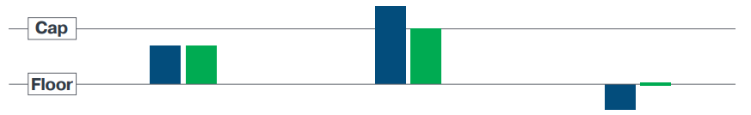
How it Works: Capped Accounts with a Floor
When index growth is between the cap and floor, the credited interest rate is equal to the change in the index.
When index growth exceeds the cap, the credited interest rate is equal to the cap.
When index growth is below the floor, the credited interest rate is equal to the floor – ensuring there is no loss of value due to poor index performance.
Please note: The charts above are intended to provide a basic understanding of 'how' the different types of indexed accounts work. All examples are hypothetical and do not guarantee or predict actual values or performance. Results will vary.
For financial professional use only.
© 2025 Penn Mutual. All rights reserved.

Slide 9
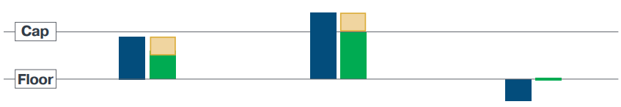
How it Works: Capped Accounts with a Spread and a Floor
When index growth is between the cap and floor, the credited interest rate is equal to the change in the index reduced by the spread but will never be less than the floor.
When index growth exceeds the cap, the credited interest rate is equal to the change in index reduced by the spread, up to the cap.
When index growth is below the floor, the credited interest rate is equal to the floor – ensuring there is no loss of value due to poor index performance or the spread.
Please note: The charts above are intended to provide a basic understanding of 'how' the different types of indexed accounts work. All examples are hypothetical and do not guarantee or predict actual values or performance. Results will vary.
For financial professional use only.
© 2025 Penn Mutual. All rights reserved.

Slide 10
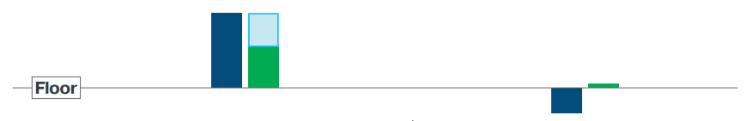
How it Works: Uncapped Accounts with a Floor
When index growth is above the floor, the credited interest rate is equal to the change in the index multiplied by the participation rate.
When index growth is below the floor, the credited interest rate is equal to the floor – ensuring there is no loss of value due to poor index performance.
Please note: The charts above are intended to provide a basic understanding of 'how' the different types of indexed accounts work. All examples are hypothetical and do not guarantee or predict actual values or performance. Results will vary.
For financial professional use only.
© 2025 Penn Mutual. All rights reserved.

Slide 11
How it Works:
What causes changes to an indexed account’s cap, participation and spread rate?
It comes down to two factors: The amount available to purchase options (which is based on interest earned from investments) and the cost of options (which is based on market volatility)
Long-term Interest Rate Environment | and /or | Market Volatility |  | Outcome
Low interest rates Result: Carrier earns less on its investments, so the amount available to purchase options is smaller |  | High volatility Result: The cost of options goes up |  | Lower caps Lower participation rates¹ Higher spread rates
High interest rates Result: Carrier makes more on its investments, so the amount available to purchase options is bigger |  | Low volatility Result: The cost of options goes down |  | Higher caps Higher participation rates¹ Lower spread rates
¹Applies only to accounts with non-guaranteed participation rates.
For financial professional use only.
© 2025 Penn Mutual. All rights reserved.

Slide 12
Indexed Universal Life Insurance
Comparing Indexed Options
For financial professional use only. © 2025 Penn Mutual. All rights reserved.
12

Slide 13
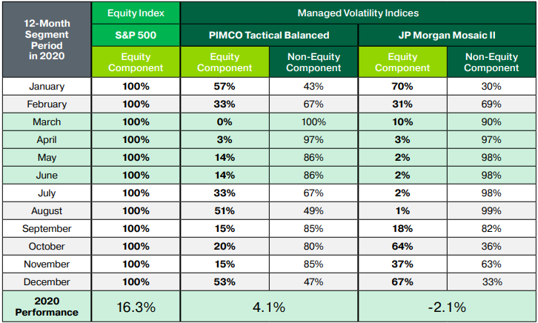
Equity vs. Managed Volatility Indices:
How they compare in a volatile market
This chart uses a 12-month segment period starting January 2020 to show how the monthly shifts in equity
vs. non-equity component weighting can impact the performance of managed volatility indices.
For financial professional use only.
© 2025 Penn Mutual. All rights reserved.

Slide 14
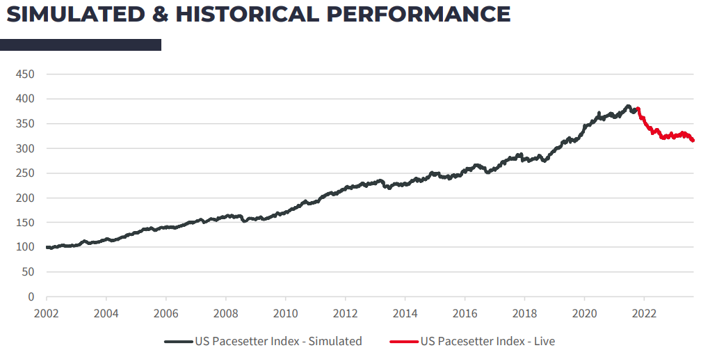
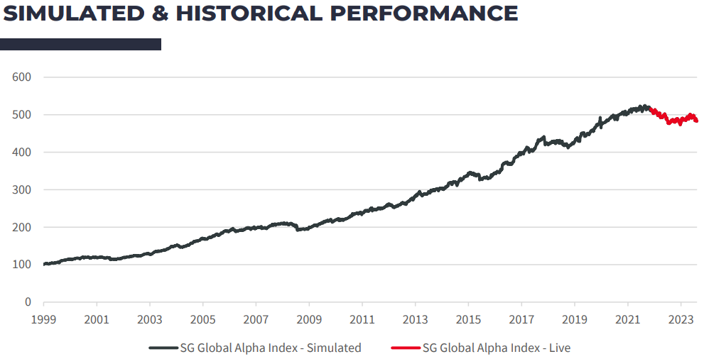
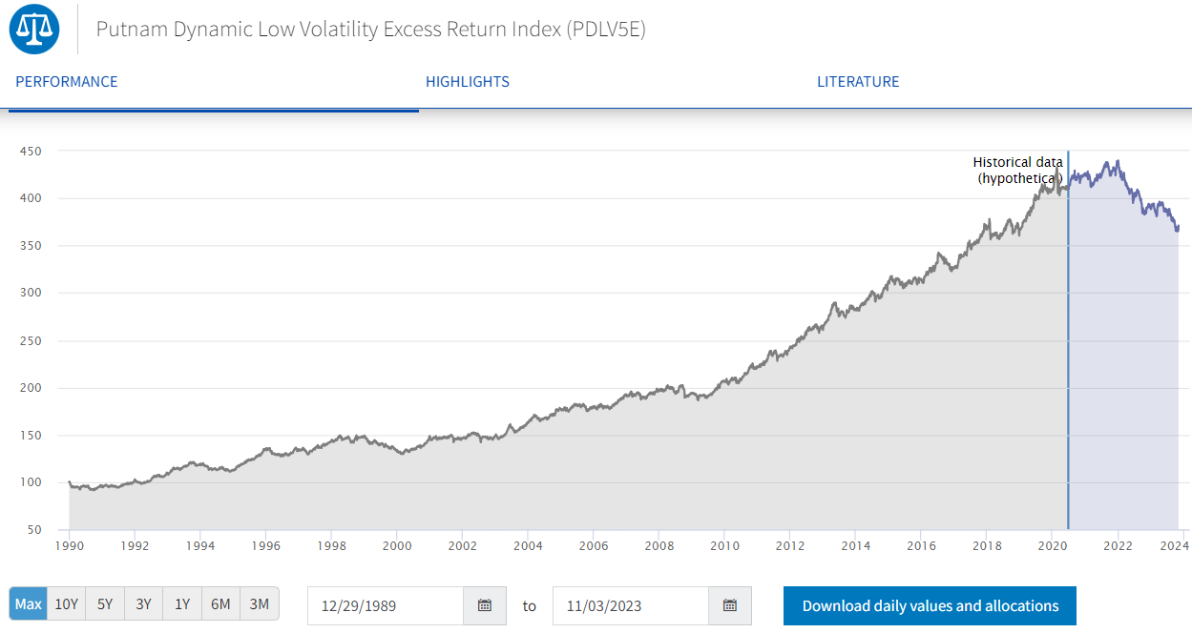
Marketing Managed Volatility Indexed Accounts
Hypothetical back-casted indexed performance vs. actual performance since inception
Company | Index | Live Date | 2022 Return | 2023 Return | 2024 Return | Return Since Live Date
All | S&P 500 | 3/4/1957 | -19.44% | 24.23% | 23.31% | 10.13%¹
Managed Volatility Indexed Strategies
Securian | SG Global Alpha | 2/1/2022 | -7.6% | 4.10% | 4.80% | -0.67%
Symetra | Putnam Low Volatility Excess Return | 6/24/2020 | -11.62% | -2.21% | -1.49% | -1.82%
Nationwide | JP Morgan Mercury | 4/25/2022 | -12.38% | -1.10% | -2.55% | -3.18%
Nationwide | Goldman Sachs New Horizons | 3/2/2022 | -3.69% | 2.57% | 1.88% | 0.97%
John Hancock | Barclays Global MA | 9/13/2021 | -15.13% | 7.81% | 0.56% | -2.11%
National Life | US Pacesetter | 12/10/2021 | -15.13% | 1.90% | -1.50% | -3.95%
¹ Average Annualized return.
For financial professional use only.
© 2025 Penn Mutual. All rights reserved.

Slide 15
Managed Volatility vs. S&P 500
Company | Managed Vol Index¹ | 2024 Managed Vol Return | Managed Vol Par Rate | Managed Vol Index Credit | S&P Cap Rate | S&P Index Credit
Securian | SG Global Alpha | 4.80% | 105% | 5.04% | 10.50% | 10.50%
Symetra | Putnam Low Volatility Excess Return | -1.49% | 189% | 0.00% | 11.50% | 11.50%
Nationwide | JP Morgan Mercury | -2.55% | 205% | 0.00% | 10.25% | 10.25%
Nationwide | Goldman Sachs New Horizons | 1.88% | 260% | 4.89% | 10.00% | 10.00%
John Hancock | Barclays Global MA | 0.56% | 165% | 0.92% | 9.50% | 9.50%
National Life | US Pacesetter | -1.50% | 260% | 0.00% | 9.25% | 9.25%
¹ Additional bonuses, spreads, charges, etc. may apply to the indices outlined above and were not considered for this table
For financial professional use only.
© 2025 Penn Mutual. All rights reserved.

Slide 16
Why Penn Mutual
Get to Know Our Accumulation IUL
For financial professional use only. © 2025 Penn Mutual. All rights reserved.
16

Slide 17
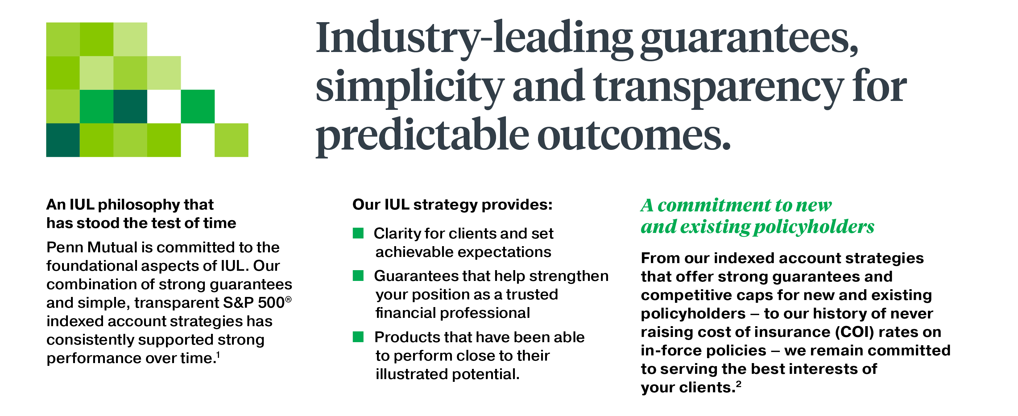
AIUL Product Philosophy
¹Past performance is not indicative of future results.
²COI statement accurate as of December 2023. Current COIs are not guaranteed and are subject to change in the future.
For financial professional use only.
© 2025 Penn Mutual. All rights reserved.

Slide 18
Accumulation IUL Indexed Account Strategies
Diverse and transparent S&P 500 Indexed Accounts with industry-leading guarantees
Capped S&P 500 | Uncapped S&P 500
Account | 1-Year with 1% Floor | 1-Year with 0% Floor | 1-Year with 0% Floor and 3% Spread | 1-Year with 1% Floor | 1-Year with 0% Floor | 2-Year with 0% Floor
Cap | 9.25% | 10.25% | 14.50% | None | None | None
Participation | 100% | 100% | 100% | 55% | 63% | 85%
Spread | N/A | N/A | 3.00% | N/A | N/A | N/A
Floor | 1.00% | 0.00% | 0.00% | 1.00% | 0.00% | 0.00%
PVE | Guaranteed 0.25% starting in policy year 1; 0.50% the later of policy year 11 or attained age 50 for Accumulation IUL
Maximum Illustrated Rate | 6.22% | 6.45% | 6.04% | 5.45% | 5.88 % | 6.22%
Stability
Growth
Stability
Growth
For financial professional use only.
© 2025 Penn Mutual. All rights reserved.
18
Notes:
1 Year 0% Floor with 3% Spread- ¹ Cap Rate is applied AFTER the spread rate
2 year with 0% Floor- PVE applied annually

Slide 19
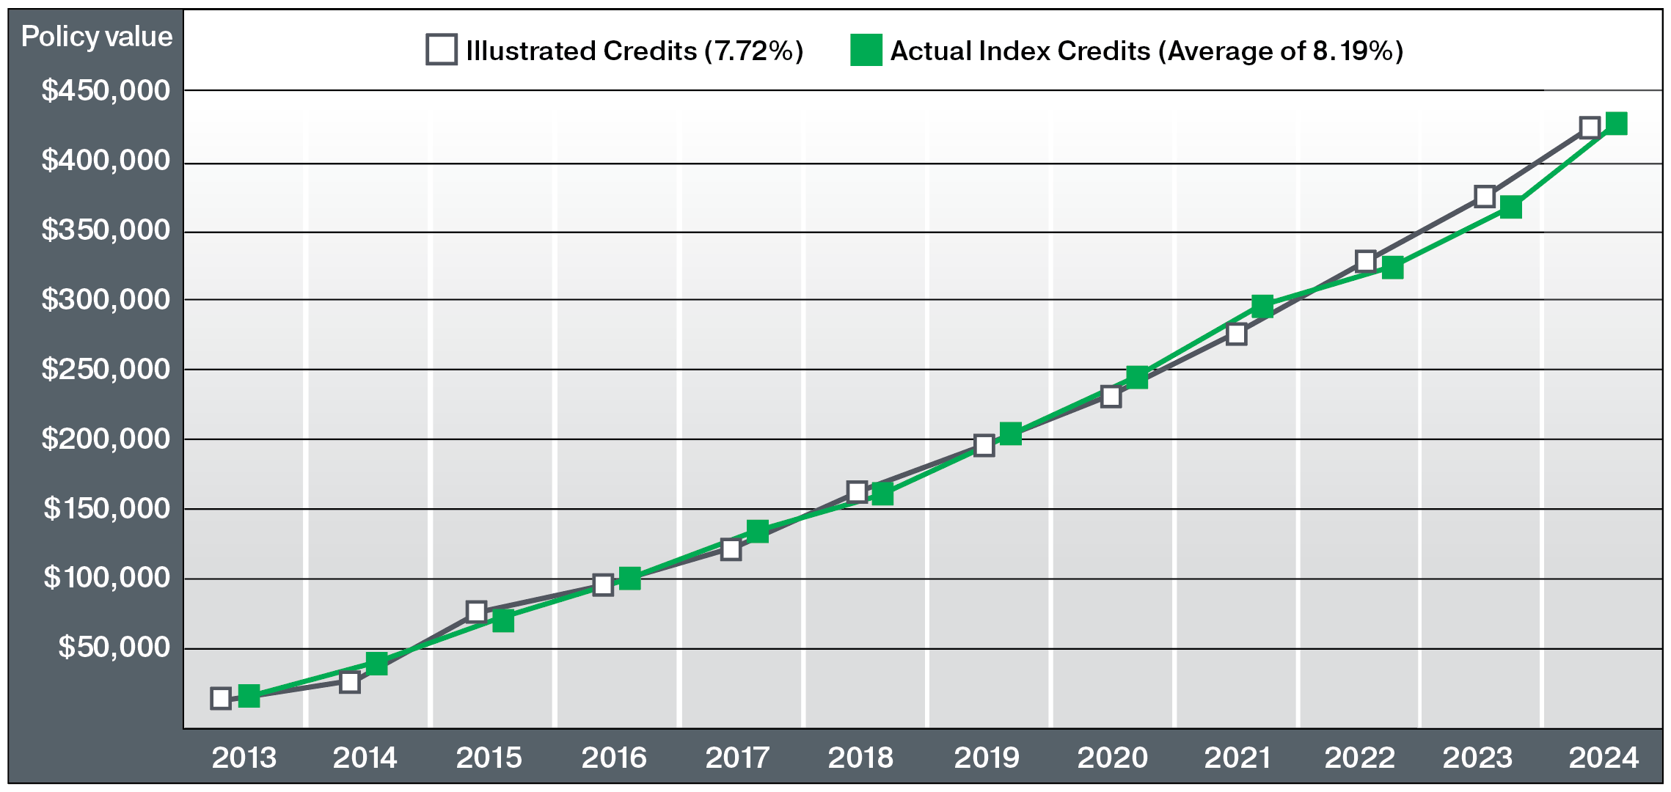
Our IUL Products Have a Track Record
of Living Up to their Illustrations
Assumptions: The chart reflects a comparison of end of year values only. Accumulation Builder Choice IUL issued January 1, 2013; Face amount $559,450; Annual Premium $25,000; Male, Age 45, Preferred Non-Tobacco, Increasing Death Benefit. Actual performance assumes no distributions, no changes to the policy and/or any other policyholder actions that differ from what was originally illustrated (2013 through 2023).
For financial professional use only.
© 2024 Penn Mutual. All rights reserved.
19
For financial professional use only.
© 2025 Penn Mutual. All rights reserved.

Slide 20
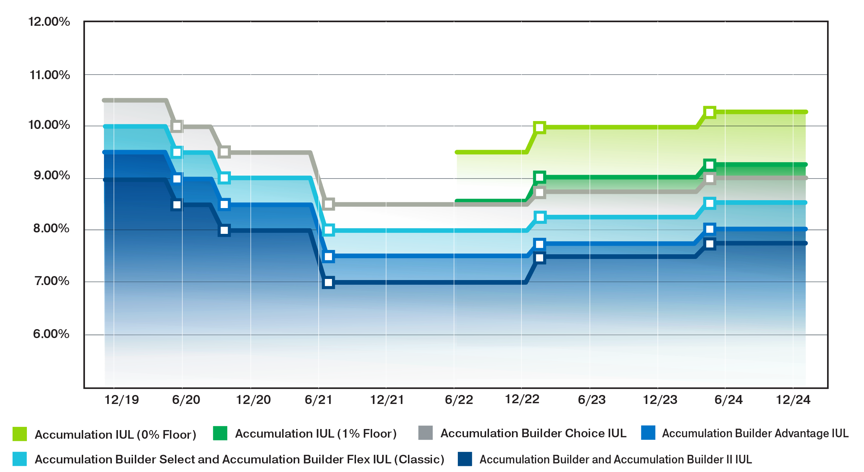
Consistent with our IUL Philosophy, We Manage
In-force and New Business in Tandem
Rate
For financial professional use only.
© 2024 Penn Mutual. All rights reserved.
20
For financial professional use only.
© 2025 Penn Mutual. All rights reserved.

Slide 21
IUL
Income Options
For financial professional use only. © 2025 Penn Mutual. All rights reserved.
21

Slide 22
Accumulation IUL and Survivorship IUL
Variety of options to access IUL policy value to accommodate different retirement income solutions
Partial Withdrawals
Traditional Loans
Indexed Loans
2.00% fee up to a maximum of $25
5.30% adjustable loan rate
5.00% fixed loan rate (guaranteed)
Withdrawals or loans are removed proportionally from Indexed Account, Fixed Account and Holding Account values
Policy value removed from Indexed Account segments prior to the maturity dates is still eligible for partial interest crediting based upon the time it was held in an indexed account
For financial professional use only.
© 2025 Penn Mutual. All rights reserved.
22

Slide 23

What Happens if the Client Takes a Loan in the Middle of a Segment Period?
The loan value is removed from the segment, BUT…
  Penn Mutual calculates index credits using the Monthly Average Segment Value (MASV). The client gets index credits for their time in the segment prior to a loan being taken out
  This allows the client to take a loan when they need it and not worry about losing out on all potential interest earned on the index credits at segment maturity
For financial professional use only.
© 2025 Penn Mutual. All rights reserved.
23

Slide 24
Interest Credit Example with No Loan
In this example no loan is taken:
Segment start value is $1,000
Segment ending value, before credits is $868
Monthly average segment value is $934
  - 10% Index Performance = $93.40
Segment Value
Months
For financial professional use only.
© 2025 Penn Mutual. All rights reserved.
24

Slide 25
Interest Credit Example with a Traditional Loan
In this example a $250 loan is taken in month 11:
Segment start value is $1,000
Segment ending value, before credits is $618
Monthly average segment
value is $892.33
  - 10% Index Performance = $89.23
Segment Value
Months
For financial professional use only.
© 2025 Penn Mutual. All rights reserved.
25

Slide 26
Additional Upside Potential with Indexed Loans
In this example a $250 indexed loan is taken in month 11:
Indexed Loan segment start
value is $250
Indexed Loan annual charge
is 5.00% ($12.50)
Indexed Loan guaranteed credit
is 1.25% ($3.12)
Indexed Loan capped credit
is 8.25%¹ ($20.62)
Segment Value
Months
Indexed Loan Segment starts in month 11
5.00% Loan Charge Rate (Guaranteed)
5.00%
$250
¹Cap = 8.00%, PVE = 0.25%
1.25%
8.25%
For financial professional use only.
© 2025 Penn Mutual. All rights reserved.
26

Slide 27
Traditional Loans vs. Indexed Loans
 | Traditional Loans | Indexed Loans
Rate: | Adjustable loan rate set annually | Fixed rate
Current Rate: | 5.30% | 5.00%
Loan Crediting: | 1.00% less loan rate in years 1-5; Equal to loan rate in years 6+ (Current) 1.00% less loan rate in years 1-10; 0.25% less in years 11+ (Guaranteed) | Based on change in value of the S&P 500 Index subject to a minimum guarantee (1% floor), growth cap ( 8.00% Current, 3% guaranteed), and 100% participation
Guaranteed Net Cost | 1.00% in years 1-10 0.25% in years 11+ | Subject to market performance with a minimum guarantee of 1.25% in years 1-10; and 1.50% in years 11+ with a cap of 8.25% in years 1-10, going up to 8.50% in years 11+ Participation is guaranteed at 100%
For financial professional use only.
© 2025 Penn Mutual. All rights reserved.

Slide 28
Indexed Universal Life Insurance
Case Study: Guarantees with Opportunities for Growth & Income
For financial professional use only. © 2025 Penn Mutual. All rights reserved.
28

Slide 29

Case Study: Guarantees with Opportunities for Growth & Income
Marty is planning for retirement and is looking for a secure way to maximize
his assets for retirement and also protect his family along the way
Preferred, Non-Tobacco class
Would like to max fund the policy
Currently has a $1 million insurance need
Savvy investor interested in keeping
pace with the markets while limiting his downside risk
Would like to supplement his income in retirement by taking income from this policy
Marty,
Age 45
For financial professional use only.
© 2025 Penn Mutual. All rights reserved.
29

Slide 30
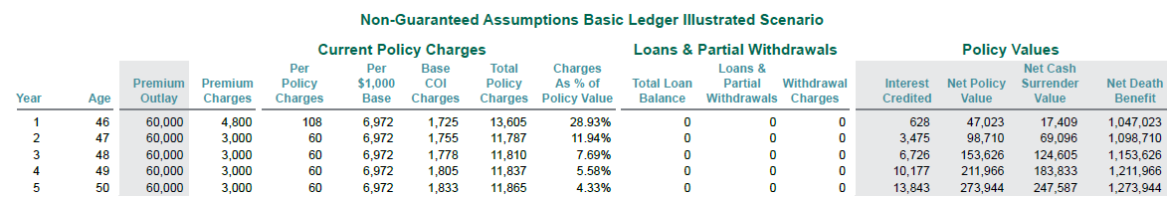
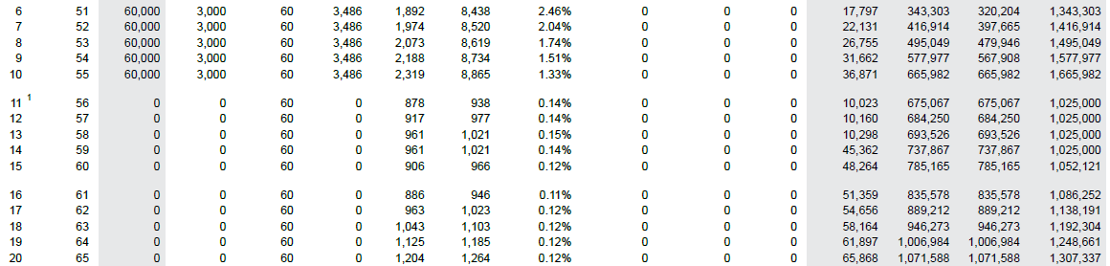
How Does this Strategy Affect His Costs?
Assumptions: Male Age 45 (Preferred Non-Tobacco); $1,000,000 initial death benefit and $60,000 annual premium for 10 years, Invested into Capped 1-year, 1% Floor Indexed Account, 6% Interest Credited in years 1-10, Minimum of 1% Credited in years 11-13 and then returning to 6% Interest Credited in years 14+
For financial professional use only.
© 2025 Penn Mutual. All rights reserved.
30

Slide 31
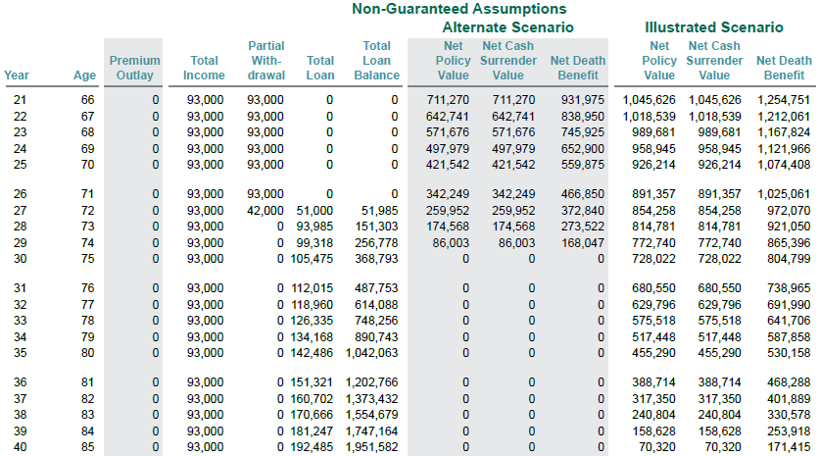
Retirement Income with AIUL
In addition, AIUL provides Marty with $93,000 per year in supplemental retirement income for 20 years
Assumptions: Male Age 45 (Preferred Non-Tobacco); $1,000,000 initial death benefit and $60,000 annual premium for 10 years, Invested into Capped 1-year, 1% Floor Indexed Account, 6% Interest Credited in years 1-10, Minimum of 1% Credited in years 11-13 and then returning to 6% Interest Credited in years 14+
For financial professional use only.
© 2025 Penn Mutual. All rights reserved.
31

Slide 32
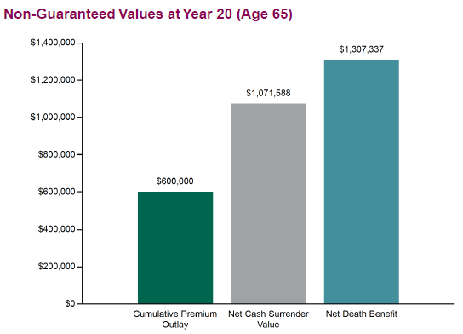
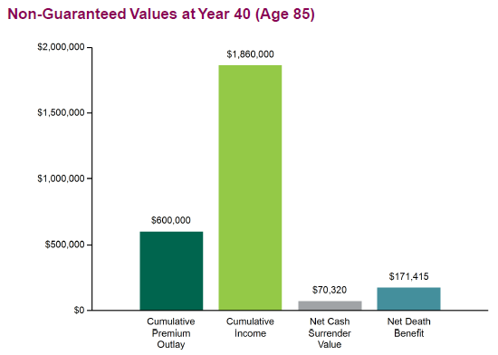
Accumulation IUL
AIUL provides Marty with the guarantees, opportunities for growth and income
over time that he’s looking for
Non-Guaranteed Values at Year 20 (Age 65)
Non-Guaranteed Values at Year 40 (Age 85)
Assumptions: Male Age 45 (Preferred Non-Tobacco); $1,000,000 initial death benefit and $60,000 annual premium for 10 years, Invested into Capped 1-year, 1% Floor Indexed Account
For financial professional use only.
© 2025 Penn Mutual. All rights reserved.
32

Slide 33
Case Study Summary: Guarantees with Opportunities for Growth & Income
Marty is able to significantly grow his cash surrender value over time and provide a meaningful contribution to his retirement income all while protecting his family along the way
AIUL offers the potential for significant cash value accumulation, with the flexibility to adjust investments
AIUL offers the peace of mind to control Marty’s downside risk while still allowing for upside potential
AIUL was able to deliver on Marty’s goals, including providing $93,000 in annual retirement income
Marty,
Age 45
For financial professional use only.
© 2025 Penn Mutual. All rights reserved.
33

Slide 34

Summary
Indexed Universal Life
Options to meet different client needs:
          Accumulation IUL
          Survivorship IUL
Upside potential with S&P 500 indexed strategies that include both capped and uncapped accounts
Downside protection with guaranteed
1% floor options available
For financial professional use only.
© 2025 Penn Mutual. All rights reserved.
34

Slide 35
Penn Mutual Life Sales Desk
Phone: 800-818-8184,
Option 4,
Email: lifesalesdesk@pennmutual.com
Penn Mutual Life Advanced Sales
Phone: 800-818-8184, Option 8
Email: advancedsales@pennmutual.com
Option1 for 1847 Financial
Support and Questions
Option 2 for IFN
For financial professional use only.
© 2025 Penn Mutual. All rights reserved.
35

Slide 36
Thank You
For financial professional use only. © 2025 Penn Mutual. All rights reserved.
36

Slide 37
For financial professional educational purposes only and should not be considered as specific investment or planning advice or distributed to the general public.
All guarantees are based on the claims-paying ability of the issuer.
Accumulation IUL (Policy form ICC22-PI-IFL) is an indexed universal life policy issued by The Penn Insurance and Annuity Company, a wholly-owned subsidiary of The Penn Mutual Life Insurance Company. Survivorship IUL (Policy form ICC22-PI-IALJ) is a last-survivor indexed universal life insurance policy offered by The Penn Insurance and Annuity Company, a wholly-owned subsidiary of The Penn Mutual Life Insurance Company. Policy form numbers may vary by state. Products and features may not be available in all states. These products are not offered in New York.
Any hypothetical examples in this presentation are for illustration purposes only. Past performance is not indicative of future results.
All products mentioned are offered by The Penn Mutual Life Insurance Company or its wholly-owned subsidiaries, The Penn Insurance and Annuity Company or The Penn Insurance and Annuity Company of New York.
The "S&P 500 Index" is a product of S&P Dow Jones Indices LLC or its affiliates (“SPDJI”) and has been licensed for use by The Penn Insurance and Annuity Company. S&P®, S&P 500®, US 500, The 500, iBoxx®, iTraxx® and CDX® are trademarks of S&P Global, Inc. or its affiliates (“S&P”); Dow Jones® is a registered trademark of Dow Jones Trademark Holdings LLC (“Dow Jones”) and these trademarks have been licensed for use by SPDJI and sublicensed for certain purposes by The Penn Insurance and Annuity Company. The product is not sponsored, endorsed, sold or promoted by SPDJI, Dow Jones, S&P, their respective affiliates and none of such parties make any representation regarding the advisability of investing in such product(s) nor do they have any liability for any errors, omissions, or interruptions of the S&P 500 Index.
This presentation is intended to provide a product overview. All information including product features, availability, rates and other provisions is believed to be accurate as of March 2025 and are subject to change without notice.
7805618NS_APR27
For financial professional use only.
© 2025 Penn Mutual. All rights reserved.
37

